Slide 1
Modernizing Telecom Service Orchestration with Data Engineering
Table of Contents
Introduction to Telecom Service Orchestration
Telecom Service Orchestration using Data Engineering Tools
Summary & Q&A
Presented By
Ganashree M D
DEFT-JULY-2026

Slide 2
Introduction: What is Telecom Service Orchestration?
The Core Objective:
Automated bridge connecting business operations (BSS) with network execution (OSS).
The Dual-Layer Ecosystem:
BSS (Business Support): Manages CRM orders, customer journeys, and billing monetization.
OSS (Operations Support): Handles technical network execution and FlowOne provisioning
The End-to-End Orchestration Flow:
Order Capture: Customer places an order in BSS / CRM.
Fulfillment: Request triggers FlowOne to provision network resources.
Mediation: Network generates raw binary usage logs (CDRs) that are decoded.
Monetization: Usage is billed and synced back to BSS to complete the loop.

Slide 3
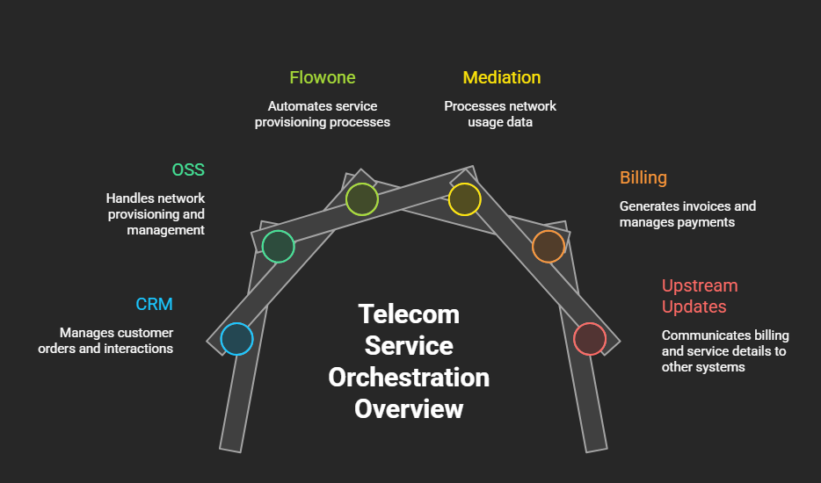

Slide 4
Telecom Service Orchestration using Data Engineering Tools
Order Capture (BSS CRM)
Sqoop pulls customer records & Kafka streams new orders instantly upon plan changes.
Network Activation (FlowOne OSS)
Airflow triggers FlowOne provisioning and tracks job execution., while Databricks logs network topology state.
Usage Collection (Mediation)
NiFi grabs raw network usage files on the fly & streams them straight into the Data Lake (AWS S3 / HDFS).
Binary Processing
Spark reads raw binary from the Data Lake, decodes it in parallel, and saves structured Parquet files back to storage.
Billing & Loopback
Decoded data is checked by Impala in the lake, loaded into Snowflake, transformed via dbt(like aggregations,matching records,checking duplicates), and synced back to CRM.

Slide 5
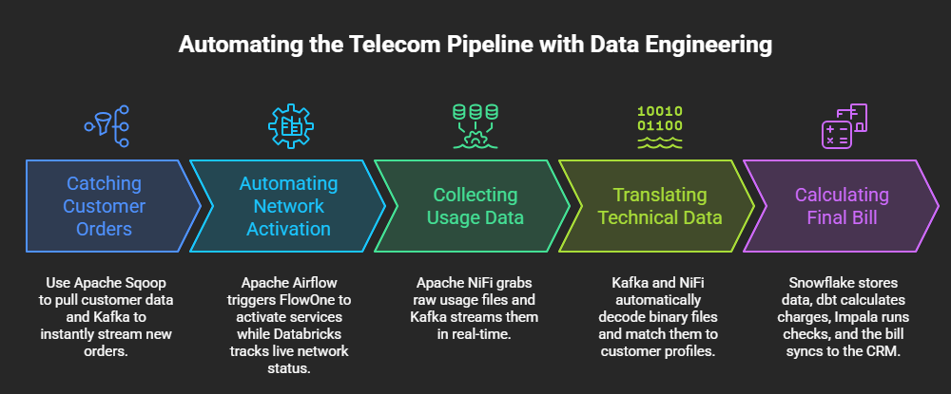

Slide 6
Thank You
Summary: Bridging BSS, FlowOne OSS, and Mediation with modern Data Engineering tools (Kafka,Nifi,sqoop,spark, PySpark, Snowflake, dbt, Airflow).
Open Floor: Questions, ideas, or feedback on applying this architecture to telecom pipelines.

